Slide 1
THE SP SYSTEM AND ITS POTENTIAL APPLICATIONS IN DEFENCE
Dr Gerry Wolff
CognitionResearch.org

Slide 2
THE SP SYSTEM
Very roughly, the SP theory of intelligence (expressed in the SP computer model) is:
■ A database system...
■ …with intelligence.

Slide 3
SIMPLIFICATION AND INTEGRATION
■ Computer science,
including artificial
intelligence, has
become very
fragmented.
tableau
Lisp
possibilistic logic
semi-graphoid
Horn clause
inheritance
variable
schema
temporal logic
LL(k) grammar
prototype theory
neural networks
simulated annealing
constraint satisfaction
inductive logic programming
operator
pushdown automaton
situation calculus
fuzzy logic
■ The SP system
aims to simplify
and integrate
observations and
concepts in AI and
related areas .
Petri nets
truth maintenance
Skolemization
object-oriented design
genetic algorithm
re-write rule
blackboard
case-based reasoning
expert system
means-ends analysis
explanation-based learning
Bayesian networks
self-organising feature maps
autoepistemic logic
logic programming
lambda calculus
n-tuple
production systems
parsing
utility theory
perceptron
ontologies
■ The key to simplification and
integration is the multiple alignment
concept (next).

Slide 4
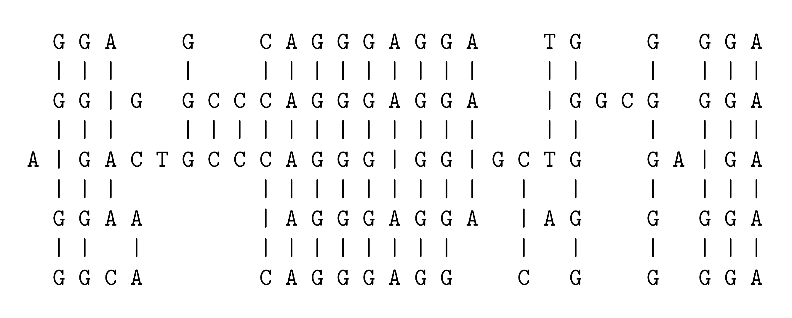
MULTIPLE ALIGNMENT: A CONCEPT BORROWED (AND ADAPTED) FROM BIOINFORMATICS
■ “Stretching” of sequences in a computer brings matching letters into line.
■ Heuristic methods are needed because the search is complicated.
Notes:
A widely-used technique for the analysis of DNA is to arrange two or more sequences so that matching bases and subsequences of bases are aligned, as shown in this figure.
In the SP theory, this idea has been borrowed and adapted. The main change is the distinction between ‘New’ and ‘Old’ patterns, with the goal of finding multiple alignments that enable New patterns to be encoded economically in terms of Old patterns.

Slide 5
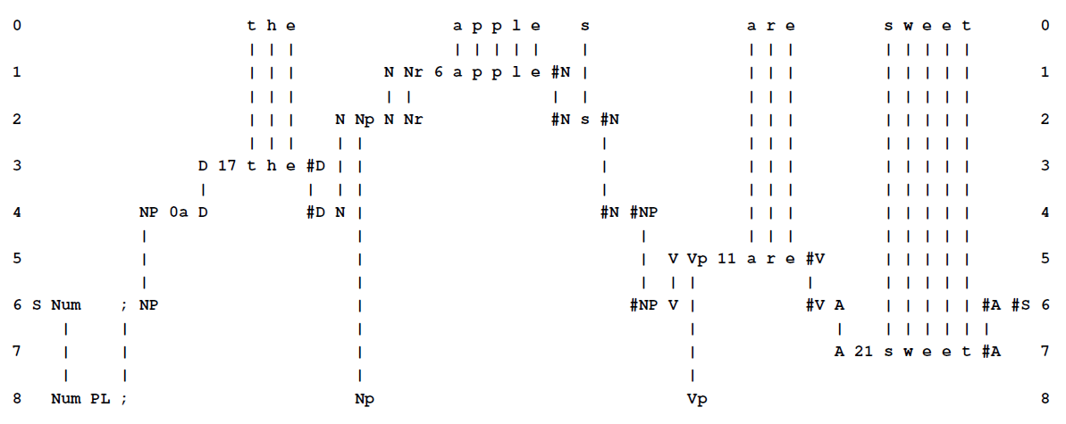
AN SP MULTIPLE ALIGNMENT
■ SP-multiple alignment is central in the SP system.
■ The versatility of SP-multiple alignment (described later) is a major discovery.
■ SP-multiple alignment could be the “double helix” of intelligence.

Slide 6
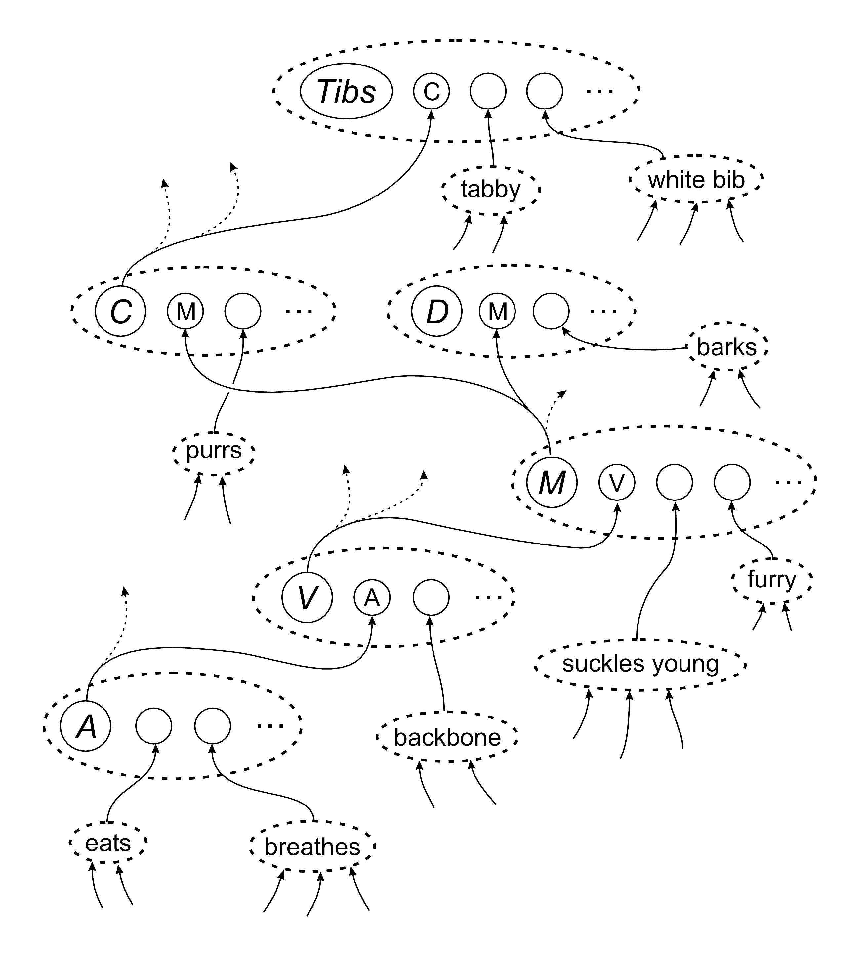
SP-NEURAL
Concepts in the SP system may be mapped into SP-neural, meaning the SP theory expressed as neurons and their inter-connections.

Slide 7
COMPARISON WITH OTHER AI-RELATED SYSTEMS
■ A recent paper describes several advantages of the SP system compared with several AI-related alternatives.
■ There are at least 14 problems with deep learning which are solved in the SP system.

Slide 8
VERSATILITY AND ADAPTABILITY OF THE SP SYSTEM
■ Unsupervised learning: a foundation for all other kinds of learning.
■ Representation of several different kinds of knowledge.
■ Several different kinds of reasoning.
■ Pattern recognition and computer vision:
  ■ Robust in the face of errors in data;
  ■ At multiple levels of abstraction.
■ Processing of natural language.
■ Information storage and retrieval.
■ Planning a route between two places.
■ Solving the kinds of problem used in IQ tests.

Slide 9
SEAMLESS INTEGRATION IN THE SP SYSTEM
■ SP-multiple alignment has potential to be a universal framework for diverse kinds of knowledge (DK) and diverse aspects of intelligence (DI).
■ This gives the SP system potential for the seamless integration of DK and DI — (SIDKDI).
■ SIDKDI appears to be essential if we are to achieve human-like fluidity, versatility and adaptability in artificial intelligence. For example, in solving “whodunnit” problems, detectives naturally make use of many different kinds of knowledge and many different aspects of intelligence.

Slide 10
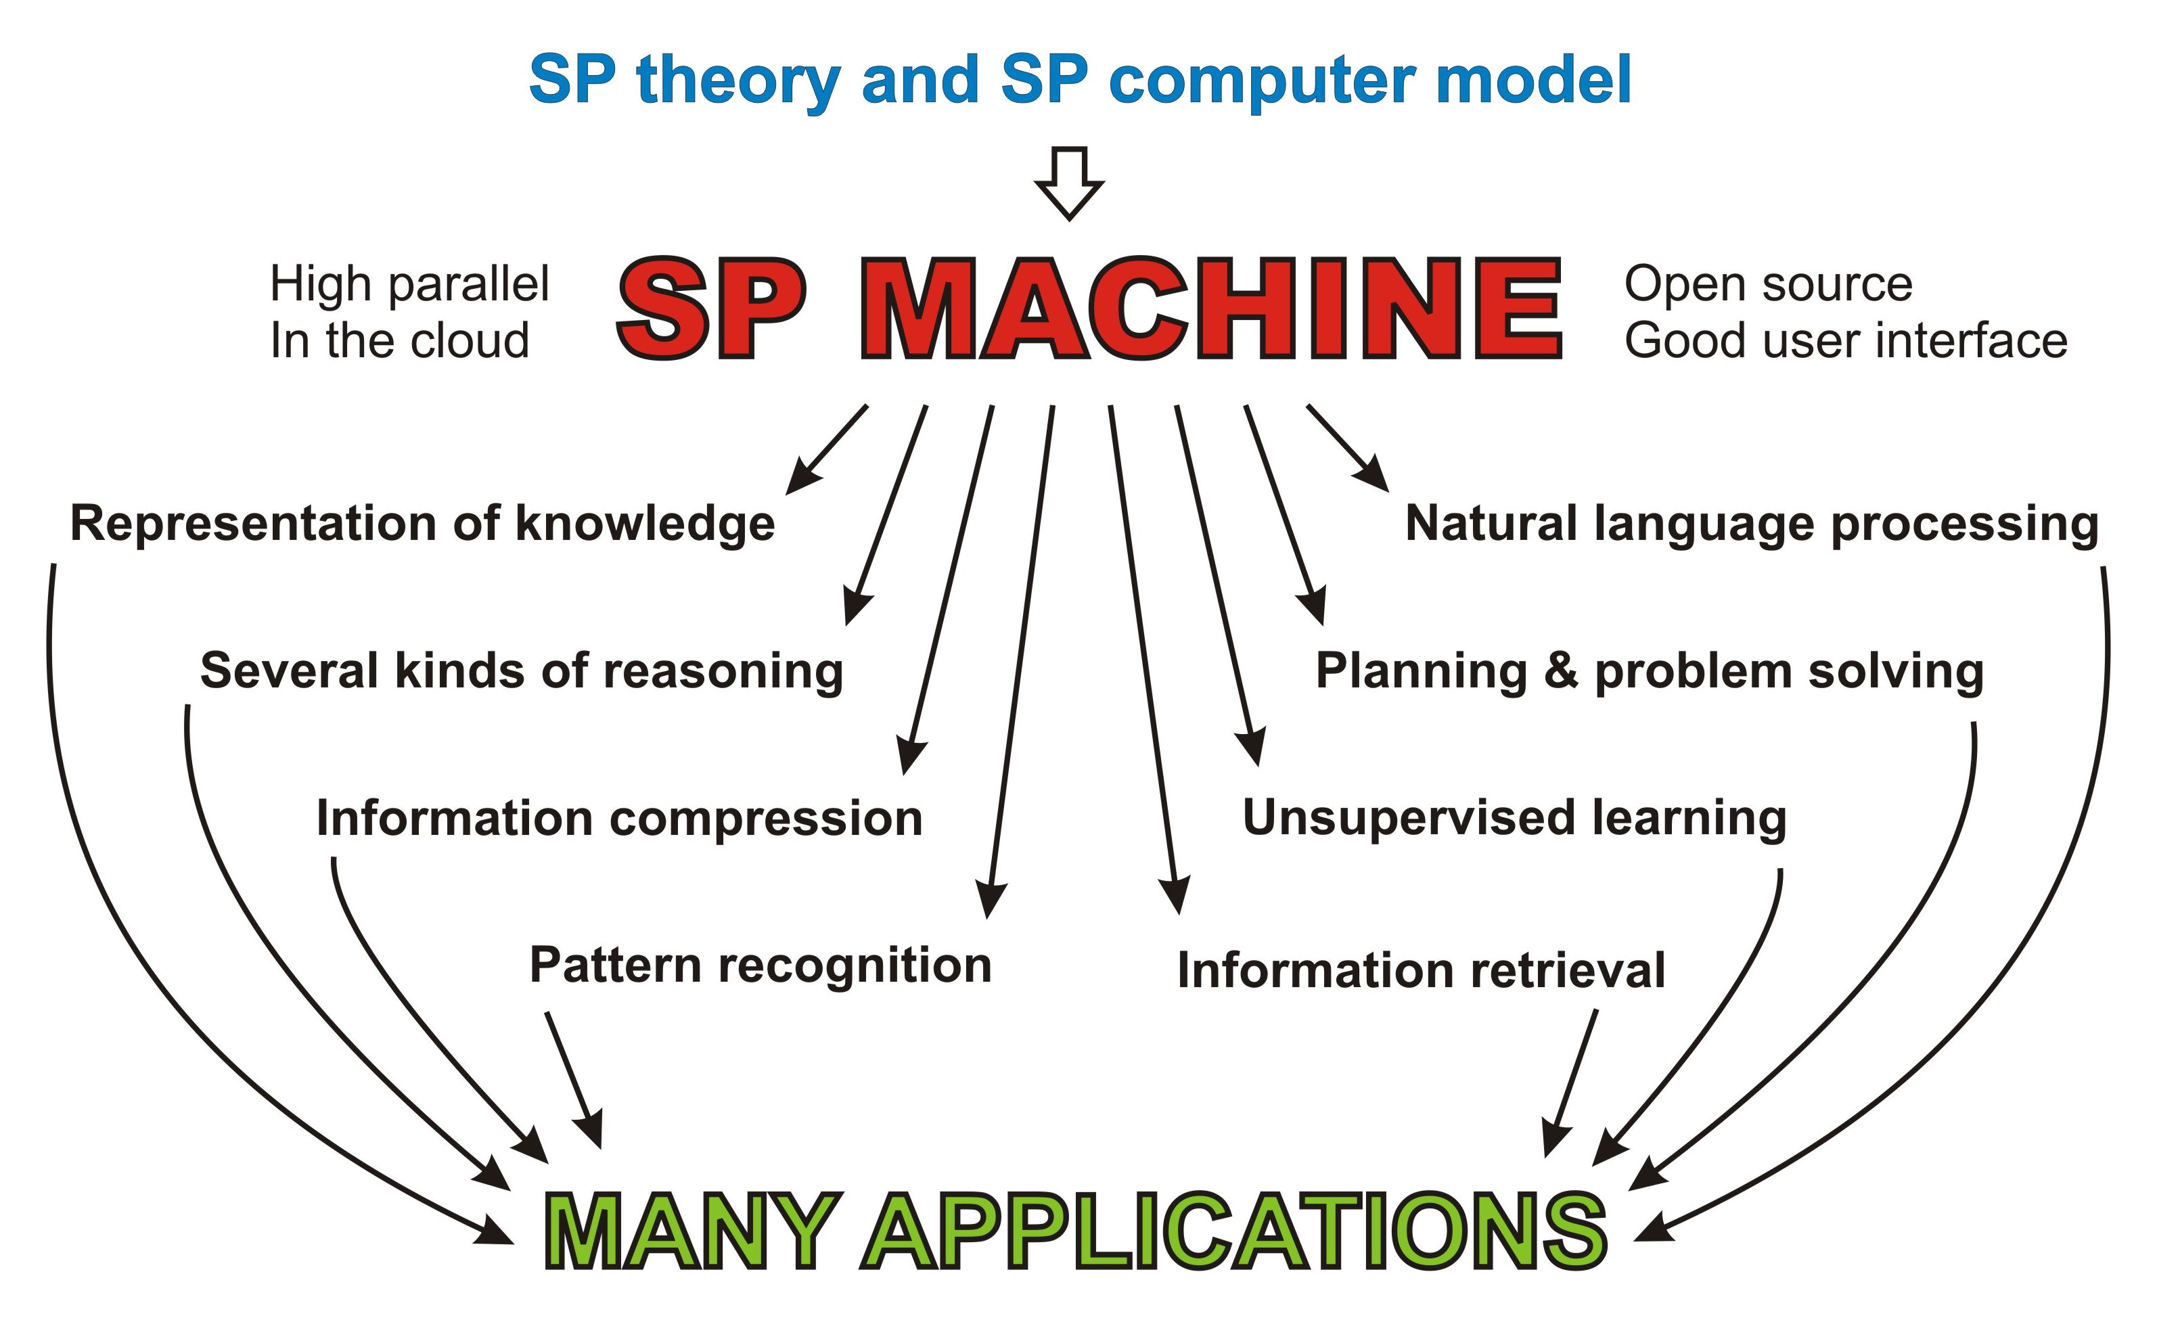
A HIGH-PARALLEL SP MACHINE AS A STEP TOWARDS AN INDUSTRIAL-STRENGTH SYSTEM, AND AS A VEHICLE FOR RESEARCH

Slide 11
THE POTENTIAL OF THE SP SYSTEM IN DEFENCE — SUMMARY
■ The SP system as a versatile database system, with intelligence.
■ Helping to solve nine problems with big data.
■ Helping to develop human-like intelligence in autonomous robots.
■ Unsupervised learning.
■ Several kinds of reasoning.
■ Planning and problem solving.
■ Pattern recognition and computer vision.
■ Processing of natural languages.
■ The detection and management of errors in data.
■ Data fusion.
■ Transparency and visualisation.

Slide 12
THE SP SYSTEM AS A VERSATILE DATABASE SYSTEM, WITH INTELLIGENCE
■ Storage of information
  ■ Efficiency in the use of storage space.
  ■ Efficiency in the transmission of information.
■ Retrieval of information
  ■ Query-by-example.
  ■ Natural language queries.
  ■ SQL.
  ■ Versatility in representing different kinds of knowledge and with different aspects of intelligence.
  ■ Seamless integration of different kinds of knowledge and different aspects of intelligence.

Slide 13
BIG DATA
The SP system can help solve nine problems with big data:
■ Overcoming the problem of variety in big data.
■ The unsupervised learning or discovery of ‘natural’ structures in data.
■ Interpretation of data: pattern recognition etc.
■ Velocity: analysis of streaming data.
■ Volume: making big data smaller.
■ Model-based coding: additional economies in the transmission of data.
■ Energy, speed, and bulk.
■ Veracity: managing errors and uncertainties in data.
■ Visualisation: knowledge structures and processing.

Slide 14
HELPING TO DEVELOP HUMAN-LIKE INTELLIGENCE IN AUTONOMOUS ROBOTS
■ Human-like versatility in skills may be developed via unsupervised learning in the SP system.
■ This contrasts with bespoke software for each skill.
■ Parallel processes may be managed via two-dimensional patterns in the SP system.

Slide 15
UNSUPERVISED LEARNING
■ The SP system has strengths and potential in unsupervised learning (the inspiration for the system).
■ It means learning without a “teacher” or anything equivalent. Most human learning is unsupervised.
■ It is the foundation for “reinforcement learning”, “learning by imitation”, “learning by being told”, and more.
■ For defence, it can mean:
  ■ The discovery of significant structures, patterns, or associations in data.
  ■ Automatic or semi-automatic organisation of unstructured or semi-structured information.

Slide 16
SEVERAL KINDS OF REASONING, WITH OTHER ASPECTS OF INTELLIGENCE
■ The SP system supports several kinds of reasoning that can work together and with other aspects of intelligence (such as planning and problem solving), in any combination. This is a major strength of the system.
■ For defence, this can mean:
  ■ Helping to anticipate and head off acts of terrorism.
  ■ Helping to work out the possible implications of knowledge about an enemy.
  ■ Helping to develop military strategies and tactics.

Slide 17
PATTERN RECOGNITION AND COMPUTER VISION
The SP system has strengths and potential in:
  ■ Recognising patterns in data, including such things as patterns of activity, or language styles, that have been previously learned by the system.
  ■ Recognising or retrieving such things as finger prints or DNA samples that are the same as or similar to a given target.
  ■ Computer vision: analysis and interpretation of scenes, recognition of people from different angles, recognition of objects and their significance, ….

Slide 18
PROCESSING OF NATURAL LANGUAGE
■ The SP system has strengths and potential in:
  ■ Parsing (analysis) and production of natural language without meanings.
  ■ Understanding natural language and production of language from meanings.
  ■ Translation between natural languages via meanings.
■ Potential applications in defence, include understanding conversations by suspects, understanding legal documents, and help in composing reports.
■ Seamless integration of NL with other aspects of intelligence.
■ More ambitious than NL in current AI applications.

Slide 19
THE DETECTION AND MANAGEMENT OF ERRORS IN DATA
■ Pattern recognition and learning are robust in the face of errors in data.
■ This allows the system to detect errors in data, including errors from deception.

Slide 20
DATA FUSION
■ Streams of information from two or more sensors often need to be combined into a coherent whole.
■ This can be done if each stream contains information, such as the time of each reading, which can be matched with corresponding information in other streams.
■ That kind of matching and merging of information is what the SP system does.

Slide 21
TRANSPARENCY AND VISUALIZATION
■ In the SP system there is transparency in:
  ■ How knowledge is organised (cf deep learning and artificial neural networks).
  ■ Processing — there is an audit trail for all processing.
■ Static and moving graphics may help visualisation of knowledge and processing.
■ This is likely to be important in:
  ■ Assessments of security against crime or terrorism.
  ■ Legal issues arising from crime or terrorism.

Slide 22
FURTHER INFORMATION
■ www.cognitionresearch.org/sp.htm .
■ Papers: There are details of several papers, many with download links, on the above web page.
■ Contact:
  ■ jgw@cognitionresearch.org,
  ■ +44 (0) 1248 712962,
  ■ +44 (0) 7746 290775.

