Slide 1
THE SP SYSTEM AS AN AID TO CRIME PREVENTION AND DETECTION (CPD)
Dr Gerry Wolff
CognitionResearch.org

Slide 2
THE SP SYSTEM
Very roughly, the SP theory of intelligence (expressed in the SP computer model) is:
■ A database system...
■ …with intelligence.

Slide 3
SIMPLIFICATION AND INTEGRATION
■ Computer science,
including artificial
intelligence, has
become very
fragmented:
tableau
Lisp
possibilistic logic
semi-graphoid
Horn clause
inheritance
variable
schema
temporal logic
LL(k) grammar
prototype theory
neural networks
simulated annealing
constraint satisfaction
inductive logic programming
operator
pushdown automaton
situation calculus
fuzzy logic
Petri nets
truth maintenance
Skolemization
object-oriented design
■ The SP system
aims to simplify
and integrate
ideas in computing.
genetic algorithm
re-write rule
blackboard
case-based reasoning
expert system
means-ends analysis
explanation-based learning
Bayesian networks
self-organising feature maps
autoepistemic logic
logic programming
lambda calculus
n-tuple
production systems
parsing
utility theory
perceptron
ontologies
■ The key to simplification and
integration is multiple alignment
(next).

Slide 4
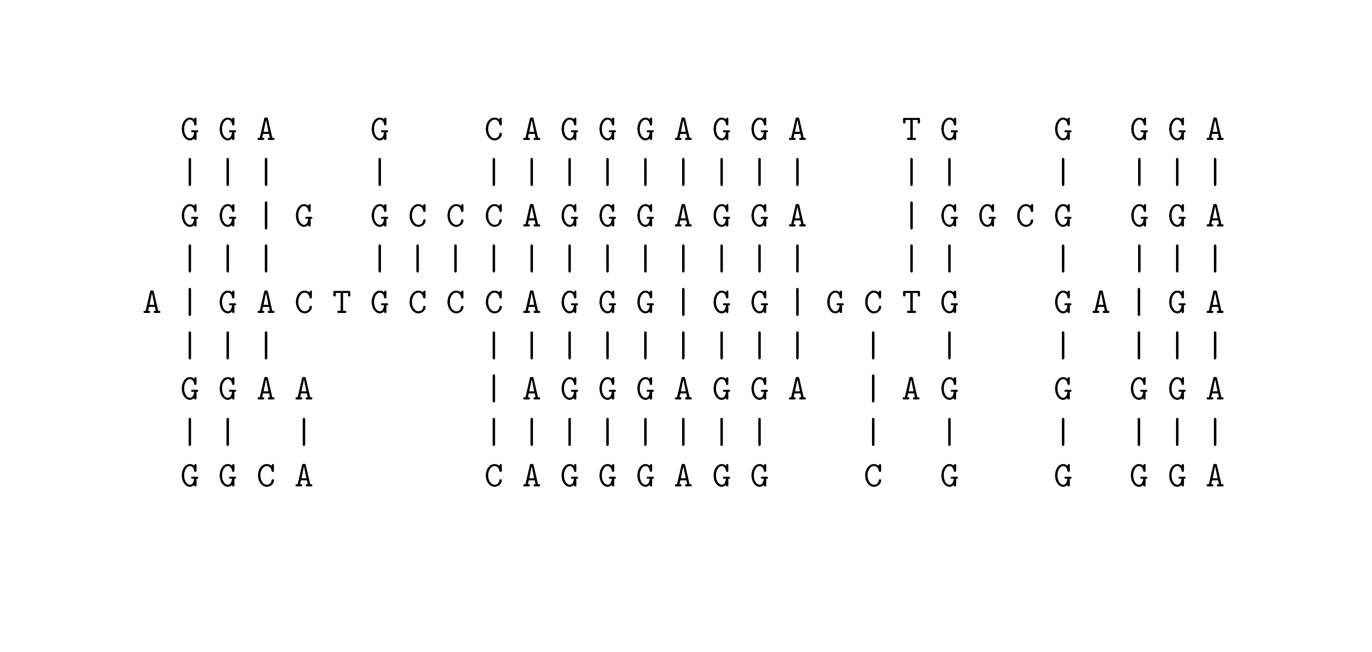
MULTIPLE ALIGNMENT: A CONCEPT BORROWED (AND ADAPTED) FROM BIOINFORMATICS
Notes:
A widely-used technique for the analysis of DNA is to arrange two or more sequences so that matching bases and subsequences of bases are aligned, as shown in this figure.
In the SP theory, this idea has been borrowed and adapted. The main change is the distinction between ‘New’ and ‘Old’ patterns, with the goal of finding multiple alignments that enable New patterns to be encoded economically in terms of Old patterns.

Slide 5
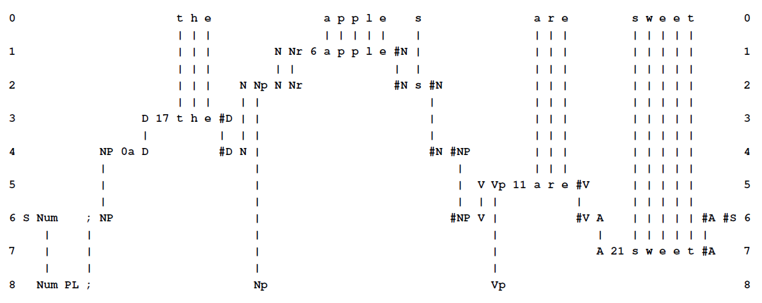
AN SP MULTIPLE ALIGNMENT
■ Multiple alignment is central in the SP system.
■ Multiple alignment is very versatile (next).

Slide 6
VERSATILITY AND ADAPTABILITY OF THE SP SYSTEM
■ Unsupervised learning: a foundation for all other kinds of learning.
■ Representation of several different kinds of knowledge.
■ Several different kinds of reasoning.
■ Pattern recognition with potential for computer vision.
■ Processing of natural language.
■ Information storage and retrieval.
■ Planning.
■ Problem solving.

Slide 7
SEAMLESS INTEGRATION IN THE SP SYSTEM
■ A potential advantage of the SP system is that it has potential for seamless integration (SI) of different kinds of knowledge (DK) and different aspects of intelligence (DI) — (SIDKDI).
■ This is because multiple alignment has potential to be a universal framework for DK and DI.
■ SIDKDI appears to be essential if we are to achieve human-like versatility and adaptability in artificial intelligence. In reasoning, people naturally make use of many different kinds of knowledge and many different aspects of intelligence. Consider reasoning in “whodunnit” scenarios.

Slide 8
THE POTENTIAL OF THE SP SYSTEM IN CPD — SUMMARY
■ The SP system as a versatile database system, with intelligence.
■ Unsupervised learning.
■ Several kinds of reasoning.
■ Planning and problem solving.
■ Pattern recognition and computer vision.
■ Processing of natural language.
■ Transparency and visualisation.

Slide 9
THE SP SYSTEM AS A VERSATILE DATABASE SYSTEM, WITH INTELLIGENCE
■ Storage of information
  ■ Efficiency in use of storage space.
  ■ Efficiency in transmission of information.
■ Retrieval of information (ED = relevant to eDiscovery)
  ■ Query-by-example.
  ■ Natural language queries.
  ■ SQL.
  ■ Versatility in representing different kinds of knowledge and with different aspects of intelligence. ED
  ■ Seamless integration of different kinds of knowledge and different aspects of intelligence. ED

Slide 10
UNSUPERVISED LEARNING
■ The SP system has strengths and potential in unsupervised learning (the inspiration for the system).
■ It means learning without a “teacher” or anything equivalent. Most human learning is unsupervised.
■ It is the foundation for “reinforcement learning”, “learning by imitation”, “learning by being told”, and more.
■ For CPD, it can mean:
  ■ The discovery of significant structures, patterns, or associations in data, including patterns of activity, associations amongst people, habits of individuals, and many more. ED
  ■ Automatic or semi-automatic organisation of unstructured or semi-structured information. ED

Slide 11
SEVERAL KINDS OF REASONING, WITH OTHER ASPECTS OF INTELLIGENCE
■ The SP system supports several kinds of reasoning that can work together and with other aspects of intelligence, in any combination. This is a major strength of the system.
■ For CPD, this can mean:
  ■ Recognising patterns of activity that precede acts of terrorism.
  ■ Working out who may be planning a crime or act of terrorism, and where, and how.
  ■ Following chains of reasoning and patterns in “whodunnit” investigations.

Slide 12
PATTERN RECOGNITION AND COMPUTER VISION
The SP system has strengths and potential in:
  ■ Recognising patterns in data, including such things as patterns of activity, or language styles, that have been previously learned by the system. ED
  ■ Recognising or retrieving such things as finger prints or DNA samples that are the same as or similar to a given target. ED
  ■ Computer vision: analysis and interpretation of scenes, recognition of people from different angles, recognition of objects and their significance, …. ED

Slide 13
PROCESSING OF NATURAL LANGUAGE
■ The SP system has strengths and potential in:
  ■ Parsing (analysis) and production of natural language without meanings.
  ■ Understanding natural language and production of language from meanings.
  ■ Translation between natural languages via meanings.
■ Potential applications in CPD, include understanding conversations by suspects, understanding legal documents, and help in composing reports.
■ Seamless integration of NL with other aspects of intelligence.
■ More ambitious than NL in current AI applications.

Slide 14
TRANSPARENCY AND VISUALIZATION
■ In the SP system there is transparency in:
  ■ How knowledge is organised (cf deep learning and artificial neural networks).
  ■ Processing — there is an audit trail for all processing.
■ Static and moving graphics may help visualisation of knowledge and processing.
■ This is likely to be important in:
  ■ Assessments of security against crime or terrorism.
  ■ Legal issues arising from crime or terrorism.

Slide 15
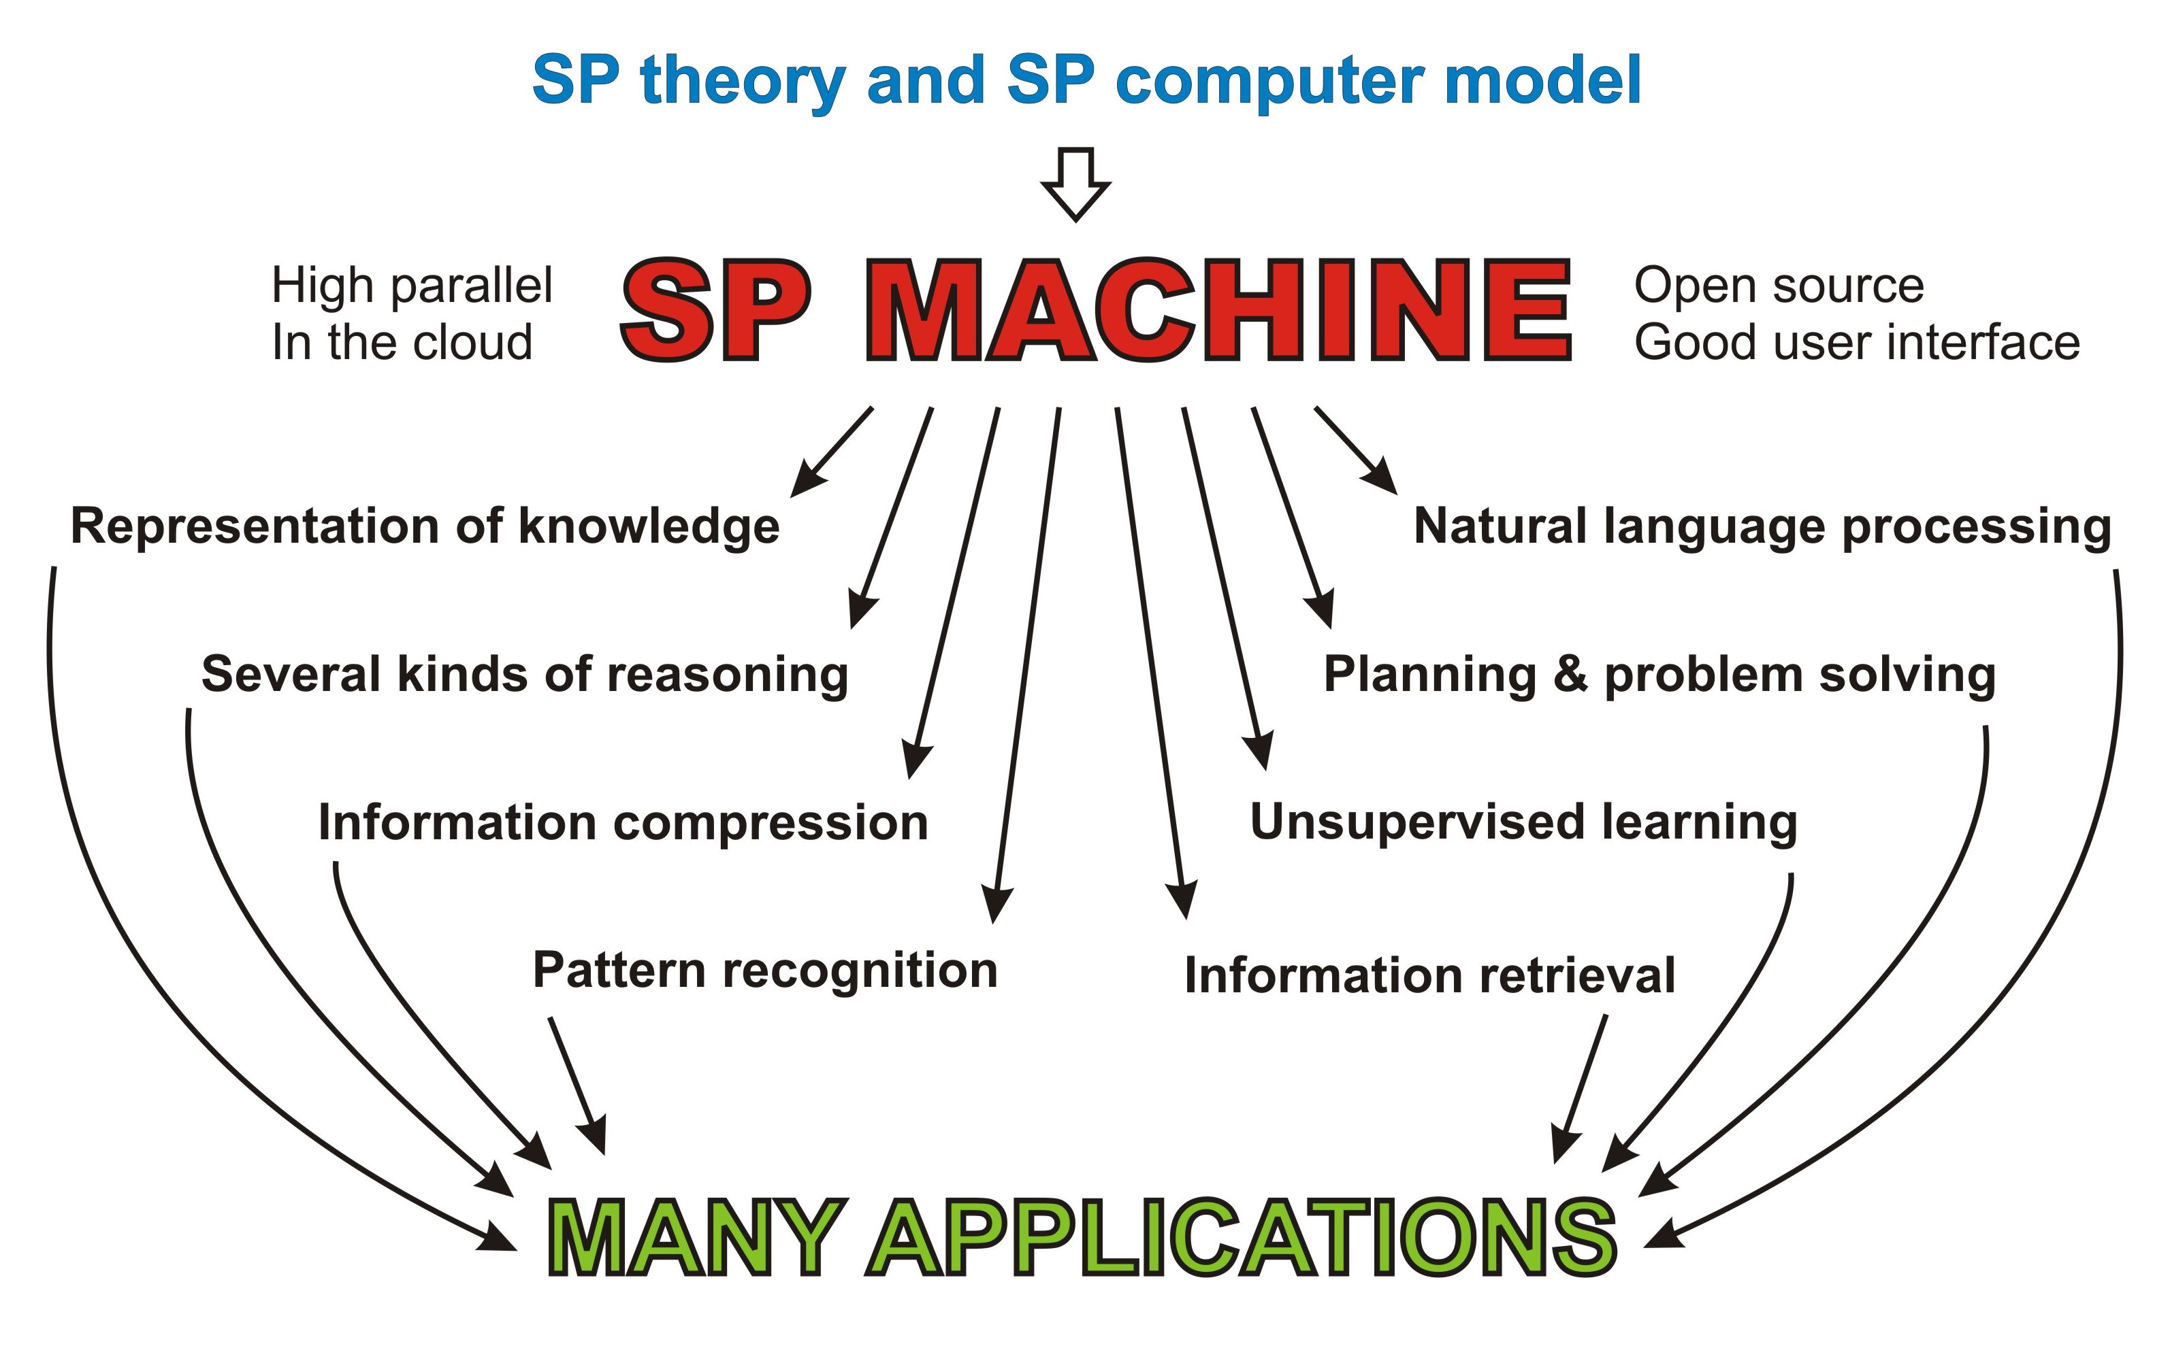
A HIGH-PARALLEL SP MACHINE AS A VEHICLE FOR RESEARCH

Slide 16
FURTHER INFORMATION
■ www.cognitionresearch.org/sp.htm .
■ Papers: There are details of several papers, many with download links, on the above web page.
■ Contact:
  ■ jgw@cognitionresearch.org,
  ■ +44 (0) 1248 712962,
  ■ +44 (0) 7746 290775.

